Slide 1

YEAR 7 DANCE

Slide 2
Which number should go in the empty triangle?
3
6
4
3
5
13
8
4
2
4
7
9
5
14
6

Slide 3
Which number should go in the empty triangle?
3
6
4
3
5
13
8
4
2
4
5
7
9
5
14
6
Add the bottom 2 numbers and divide by the top one
*Now, your turn! Come up with puzzles of your own*

Slide 4
Lesson Objective
1) DEMONSTRATE AN UNDERSTANDING OF HOW THE OLYMPICS CAN BE used as a theme for a dance routine.
2) show an understanding of what a freeze frame is.

Slide 5
Success Criteria
Level | Dance Strand
 | 1 Creating | 2 Performing | 3 Reflecting
E Entry | I can remember a range of actions I can create phrases based on a stimulus or music | I can participate in a short group performance I show some consideration of spatial awareness in performance | I can recognise when my own work and the work of others’, could be improved
1 G | I can perform simple dance phrase demonstrating choreographic skills | I can use appropriate characterisation in a performance | I can talk about why I made certain decisions in my choreography I can show a basic understanding of how a stimuli can be conveyed
2 F | I can create a choreography using unison and cannon I can learn teacher led sequences and then use these to develop my own levels I can create a choreography using a range of stimuli I can take on feedback to improve my choreography such as using levels and/or contract work I can sustain a focus within a performance | I can learn a routine and take part in simple performances | I can give suggestions on how work could be improved I can talk about my work using some dance terminology I can identify strengths and weaknesses in my own and others work
3 E | I can select and apply movement to match the given dance style I can work confidently in a group using a range of choreographic devices to explore different dance styles and ideas I can create and rehearse performance that make use of the range of techniques and dynamics to express my ideas I can give and accept suggestions to/from peers and teachers during the rehearsal process I can learn and create dances in a variety of styles | I experiment with different actions to create a performance I can create routines that are appropriate to the given style or stimuli I can experiment with different styles/actions and dynamics when developing a routine I improve and refine my performance through the rehearsal process I can choreograph a short performance for an audience I can perform a variety of different dance styles | I can reflect on and evaluate my own and other pupils’ work, suggesting improvements I can use key words when talking about dances that I have seen or participated in I can discuss the ways that ideas are communicated

Slide 6

ACTIVITY
IN GROUPS OF 4, BRAINSTORM AS MANY SPORTS AS YOU CAN THINK OF THAT ARE IN THE OLYMPICS.

Slide 7
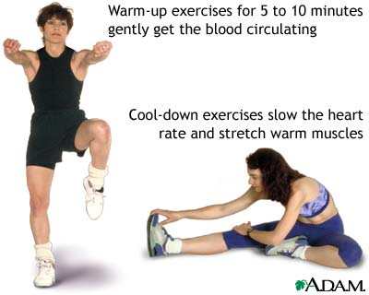
TASK ONE
FOLLOW A TEACHER LEAD WARM UP

Slide 8

TASK ONE
FOLLOW A TEACHER LEAD ROUTINE THAT IS GOING TO BE THE OPENING OF THE OLYMPIC GAMES.

Slide 9

TASK TWO
WHAT IS A FREEZE FRAME?

Slide 10
TASK THREE
IN GROUPS OF NO MORE THAN FOUR, CREATE FREEZE FRAMES ON THE FOLLOWING OLYMPICS SPORTS:
Swimming
Throwing a javelin
Starting a running race
Fencing
Gymnastics

Slide 11
TASK FOUR
NOW THAT YOU HAVE YOUR FREEZE FRAMES, SEE IF YOU CAN LINK THEM TOGETHER BY MOVEMENTS.
HOW CREATIVE CAN YOU BE!!!!!!

Slide 12

PEER ASSESSMENT TIME
EACH GROUP TO PERFORM THEIR FREEZEFRAMES WITH THE REST OF THE CLASS.
WHAT DID THE GROUP DO WELL AT
WHAT DO THE GROUP NEED TO IMPROVE ON

Slide 13
PLENARY
RECAP KEY INFORMATION FROM LAST TERM.
WHAT DOES A WARM UP CONSIST OF
WHAT ARE PERFORMANCE SKILLS
WHAT IS MUSICALITY
WHAT LEVEL ARE YOU CURRENTLY ON? WHAT DO YOU NOW NEED TO DO TO IMPROVE YOUR GRADE?
TWO STARS AND A WISH.
3 4 5 6

